Slide 1

Regression Project: Impact of Agri-Food Sector CO₂ Emissions on Climate Change

Slide 2
Objective
Quantify the impact of CO₂ emissions from the agri-food sector on climate change using regression analysis.

Slide 3
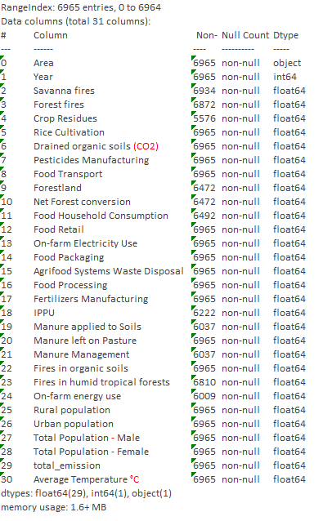
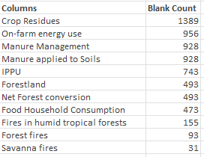
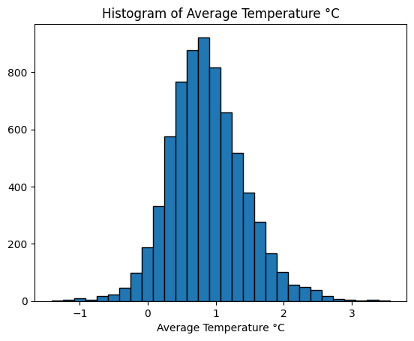
Dataset Overview
Source: co2_emissions_from_agri.csv
Blank columns filled with column medians
Temperature data is normally distributed
Column names cleaned and standardized

Slide 4
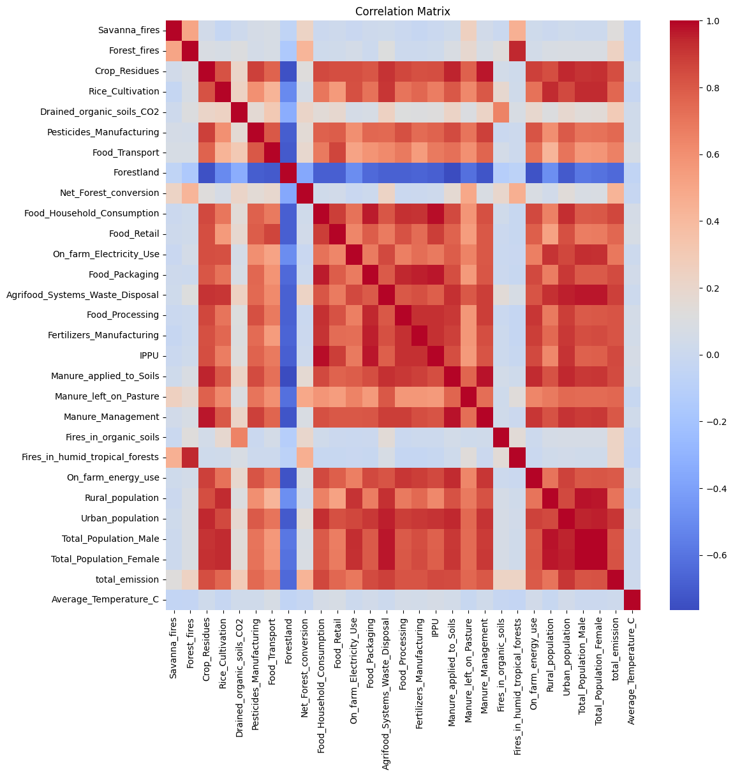
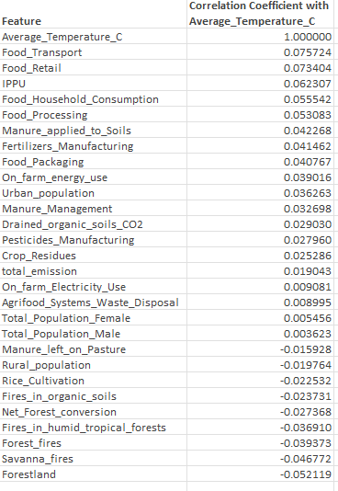
Exploratory Data Analysis (EDA)

Slide 5
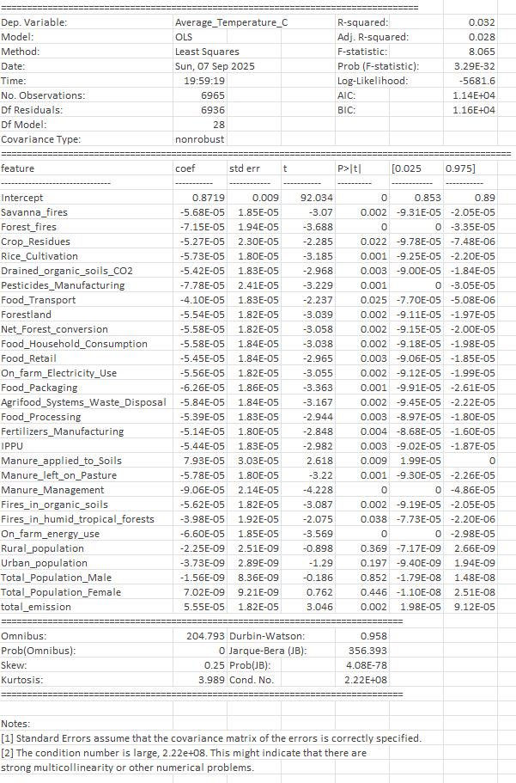
Regression Models
Linear Regression
Ridge CV
Lasso CV
Random Forest
Gradient Boosting

Slide 6
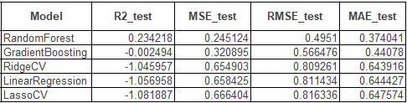
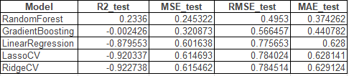
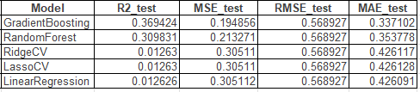
Regression Model Results
Baseline results
Results after applying logs to skew values
Results after applying bootstrapping

Slide 7
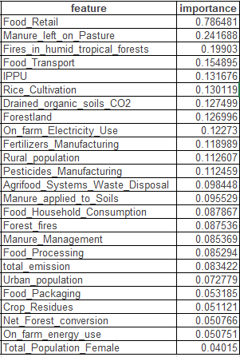
Conclusion
Best performing model was a Gradient Boosting ensemble model.
These are the top features in the model:

